Slide 1
EDUCATIONAL SERVICE CENTER OF NORTHEAST OHIO TRAINING SESSION
Presented by:
Jacqueline Walsh Brickman, Esq.
Daniel L. Lautar, Esq.
Title IX Training for K-12 Title IX Coordinators, Investigators, and Decision-makers
Independence, Ohio
August 19, 2020

Slide 2
SEXUAL HARASSMENT DEFINED
2

Slide 3
SEXUAL HARASSMENT IS DEFINED AS:
An employee conditioning the provision of an aid, benefit, or service of the school district on an individual’s participation in unwelcome sexual conduct.
Unwelcome conduct determined by a reasonable person to be so severe, pervasive, and objectively offensive that it effectively denies a person equal access to the education program or activity.
‘Sexual assault’, ‘Dating Violence’, ‘Domestic Violence’ or ‘Stalking’.
3
3

Slide 4
SCOPE OF THE EDUCATIONAL PROGRAM OR ACTIVITY
4

Slide 5
SCOPE OF THE EDUCATIONAL PROGRAM OR ACTIVITY
Title IX, at 20 U.S.C. 1681(a), provides: “No person in the United States shall, on the basis of sex, be excluded from participation in, be denied the benefits of, or be subjected to discrimination under any education program or activity receiving Federal financial assistance[.]”
“Program or activity” encompass “all of the operations of” such recipients, and such “operations” may include digital platforms.
5

Slide 6
THE GRIEVANCE PROCEDURE
6

Slide 7
THE GRIEVANCE PROCEDURE
Provide prompt and equitable resolution of student and employee complaints alleging sex discrimination/harassment.
All grievance process provisions, rules, or practices must apply equally to both parties.
A presumption that the respondent is not responsible for the alleged conduct until a determination regarding responsibility is made at the conclusion of the grievance process.
State whether the standard of evidence to be used to determine responsibility is the “preponderance of the evidence” standard or the “clear and convincing evidence” standard.
7

Slide 8
CONDUCTING AN INVESTIGATION
8

Slide 9
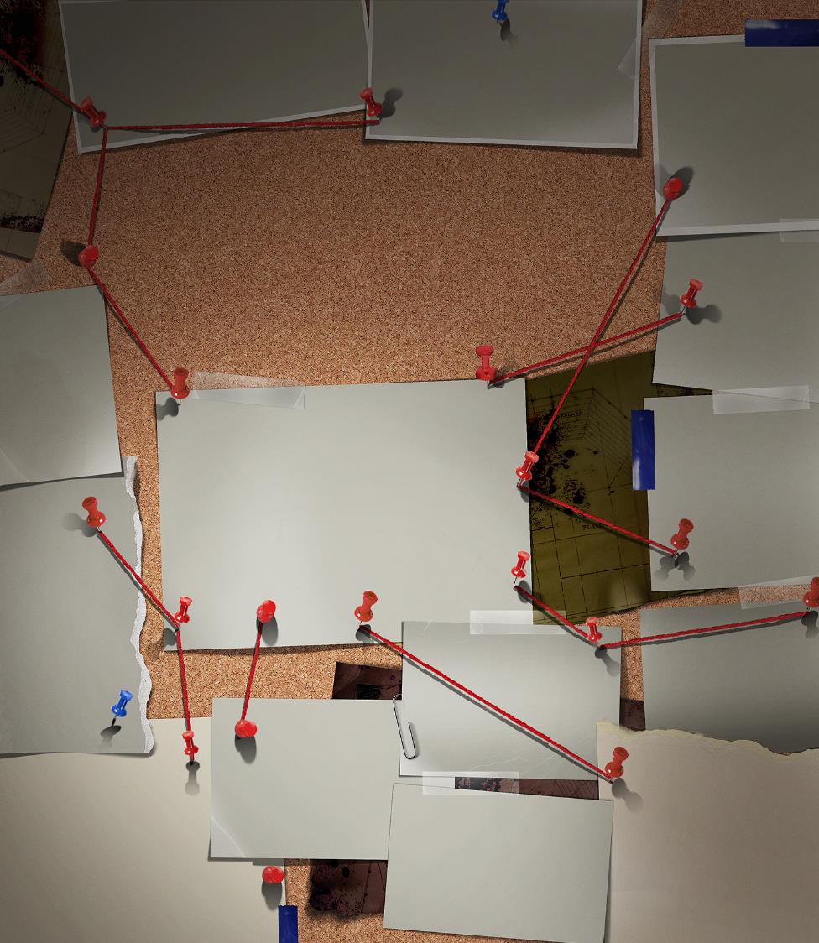
CONDUCTING AN INVESTIGATION
Notice of Complaint
A school district must provide the following written notice to the parties:
Notice of the school district’s grievance process.
Notice of the allegations.
A statement that the respondent is presumed not responsible.
Notice that the parties may have an advisor.
Notice of any provision in the school district’s code of conduct that prohibits knowingly making false statements or knowingly submitting false information during the grievance process.
9

Slide 10
CONDUCTING AN INVESTIGATION
Supportive Measures
Are non-disciplinary, non-punitive individualized services offered as appropriate.
Designed to restore or preserve equal access to the education program or activity.
May include:
Counseling.
Extensions of deadlines or other course-related adjustments.
Modifications of work or class schedules.
Campus escort services.
Mutual restrictions on contact between the parties.
Changes in work locations.
Leaves of absence.
Increased security and monitoring.
10

Slide 11
CONDUCTING AN INVESTIGATION
Supportive Measures cont…
The Title IX Coordinator must promptly contact the complainant to discuss the availability of supportive measures.
The school district must maintain as confidential any supportive measures provided.
11

Slide 12
CONDUCTING AN INVESTIGATION
Investigation Requirements
A school district must:
Ensure that the burden of proof and gathering evidence is sufficient to reach a determination regarding responsibility rest on the school district and not on the parties.
Provide an equal opportunity for the parties to present witnesses and other inculpatory and exculpatory evidence.
Cannot restrict the ability of either party to discuss the allegations or to gather and present relevant evidence.
12

Slide 13
CONDUCTING AN INVESTIGATION
Investigation Requirements cont…
A school district must:
Provide the parties with the same opportunities to have others present during any grievance proceeding.
Establish restrictions equally to both parties regarding the extent to which the advisor may participate in the proceedings.
Provide written notice of the date, time, location, participants, and purpose of all hearings, investigative interviews, or other meetings, with sufficient time for the party to prepare to participate.
13

Slide 14
CONDUCTING AN INVESTIGATION
Investigation Requirements cont…
A school district must:
Provide both parties an equal opportunity to inspect and review any evidence obtained as part of the investigation.
Prior to completion of the investigative report, the school district must send to each party the evidence subject to inspection and review and the parties must have at least 10 days to submit a written response.
Create an investigative report that fairly summarizes relevant evidence, and at least 10 days prior to any hearing, send same to each party and the party’s advisor for their review and written response.
14

Slide 15
SUMMARY OF GENERAL INVESTIGATION PROCEDURE
15

Slide 16
SUMMARY OF GENERAL INVESTIGATION PROCEDURE
The Investigator:
Must send written notice to both parties of the allegations set forth in the complaint upon receipt of a formal complaint.
Should interview the complainant and obtain a witness statement.
Should interview the respondent and obtain a witness statement.
Provide both parties the opportunity to identify witnesses and submit evidence.
Should interview any witnesses identified by the parties and obtain witness statements.
16

Slide 17
SUMMARY OF GENERAL INVESTIGATION PROCEDURE
The Investigator cont…
Should continue to interview identified witnesses, obtain witness statements, and collect copies of relevant evidence until the investigator has determined that the relevant witnesses have been interviewed and the relevant evidence has been collected.
Send the evidence to the complainant and respondent, and their advisors, for their inspection and review. Provide the complainant and respondent at least 10 days to submit a written response.
17

Slide 18
SUMMARY OF GENERAL INVESTIGATION PROCEDURE
The Investigator cont…
Consider all relevant evidence, including any responses from the complainant and respondent, before completing the investigation report.
Create an investigation report that fairly summarizes the relevant evidence. Provide the complainant and the respondent, as well as their advisors, with copies of the investigation report at least 10 days prior to any hearing.
18

Slide 19
CREATING AN INVESTIGATIVE REPORT
19

Slide 20
CREATING AN INVESTIGATIVE REPORT
Specify core purpose of fairly summarizing relevant evidence.
The investigator must determine what is relevant after the parties have reviewed the evidence.
A copy of the investigative report must be sent electronically or by hard copy to each party and the party’s advisor, if any.
Districts must maintain, for a period of seven years, records of each sexual harassment investigation.
20

Slide 21
THE HEARING
21

Slide 22
THE HEARING
Elementary and secondary schools are NOT required to use hearings (live or otherwise) to adjudicate formal complaints under Title IX.
22

Slide 23
TECHNOLOGY TO BE USED AT A LIVE HEARING
Any technology used must permit the parties to both see and hear each other. Consequently, a telephone hearing (without video) would be insufficient.
23

Slide 24
ISSUES OF RELEVANCE
24

Slide 25
ISSUES OF RELEVANCE
School districts must afford each party the opportunity to submit written, relevant questions that a party wants asked of any party or witness, and must provide each party with the answers, and allow for additional, limited follow-up questions from each party.
Questions and evidence about the complainant’s sexual predisposition or prior sexual behavior are not relevant, unless offered to prove that someone other than the respondent committed the conduct alleged by the complainant or are offered to prove consent.
25

Slide 26
ISSUES OF RELEVANCE cont…
The school district cannot access, consider, disclose, or otherwise use a party’s records that are made or maintained by a physician, psychiatrist, psychologist, or other recognized professional or paraprofessional unless the school district obtains that party’s voluntary, written consent.
The school district may not allow, rely upon, or otherwise use questions or evidence that constitute, or seek disclosure of, information protected under a legally recognized privilege, unless the person holding such privilege has waived the privilege.
26

Slide 27
FINAL DETERMINATION
27

Slide 28
FINAL DETERMINATION
Identification of allegations.
Description of procedural and process steps.
Findings of fact supporting the determination.
Conclusions regarding the application of the school district’s code of conduct to the facts.
A statement of, and rationale for, the result as to each allegation:
Remedies that do not impact the respondent should not be disclosed.
The complainant should be informed of the sanctions imposed.
The school district’s procedures and permissible bases for the complainant and respondent to appeal.
28

Slide 29
APPEALS
29

Slide 30
APPEAL
Must offer both parties an appeal from a determination regarding responsibility, on the following basis:
Procedural irregularity.
New evidence.
Conflict of interest.
Any other basis offered equally to both parties.
30

Slide 31
INFORMAL RESOLUTION PROCESS
31

Slide 32
INFORMAL RESOLUTION PROCESS
Informal resolution cannot be offered unless a formal complaint is filed. School districts must provide to the parties a written notice disclosing:
The allegations.
The requirements of the informal resolution process.
Any consequences resulting from participating in the informal resolution process.
32

Slide 33
DISMISSAL OF COMPLAINTS
33

Slide 34
DISMISSAL OF COMPLAINTS
Mandatory Dismissal:
The actions complained of do not meet the definition of “sexual harassment”.
The actions complained of were not against a person in the United States.
The actions complained of did not occur in the school district’s education program or activity.
34

Slide 35
SERVING IMPARTIALLY
35

Slide 36
SERVING IMPARTIALLY
Avoid prejudgment of the facts at issue.
The Title IX Coordinator, investigator, decision-maker(s), or any person designated to facilitate an informal resolution process, cannot have a conflict of interest or bias for or against complainants or respondents generally or an individual complainant or respondent.
A Title IX Coordinator, investigator, or decision-maker(s) may have a role in the emergency removal process as long as such a role does not result in a conflict of interest with respect to the grievance process.
36

Slide 37
CONCLUSION
37

